Slide 1
ISE467
Spotify Recommendation System

Slide 2
01
Background
Content
02
Item to item recommendation
03
Collaborative Filtering
04
Music Genres Clustering
05
Conclusion

Slide 3
Background
01
PART

Slide 4
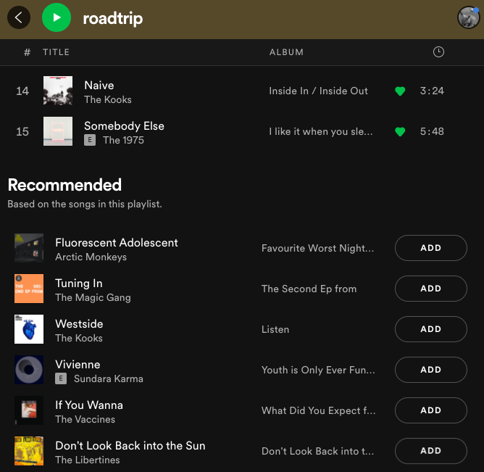
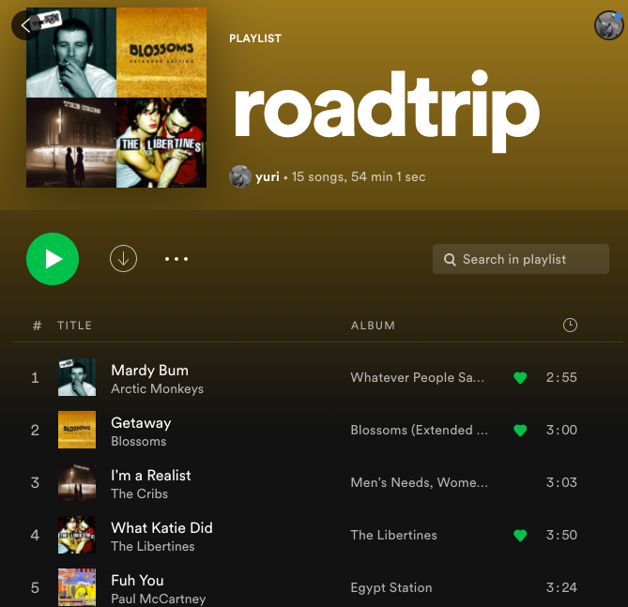
Data
Goal
recommend new songs to every playlist
Spotify Million Playlist Dataset Challenge
https://www.aicrowd.com/challenges/spotify-million-playlist-dataset-challenge
Our output

Slide 5
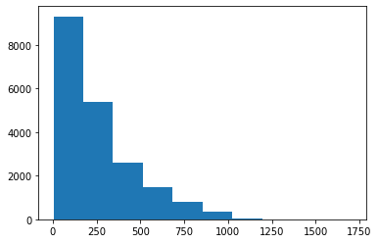
playlist length histogram(in minute)
Initial impression of the data
number of playlists | 20000
number of tracks | 1328284
number of unique tracks | 268907
number of unique albums | 123132
number of unique artists | 51826
number of unique titles | 10140
number of playlists with descriptions | 364
avg playlist length in minute | 259.74

Slide 6
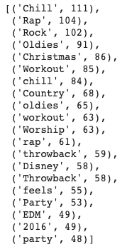
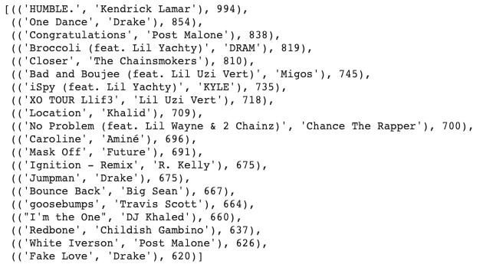
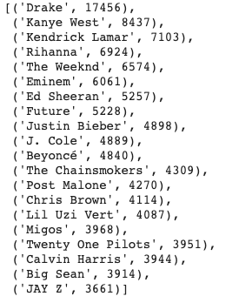
Other interesting finds
top 20 playlist titles
top 20 tracks
top 20 artists

Slide 7
Item to item recommendation
02
PART

Slide 8
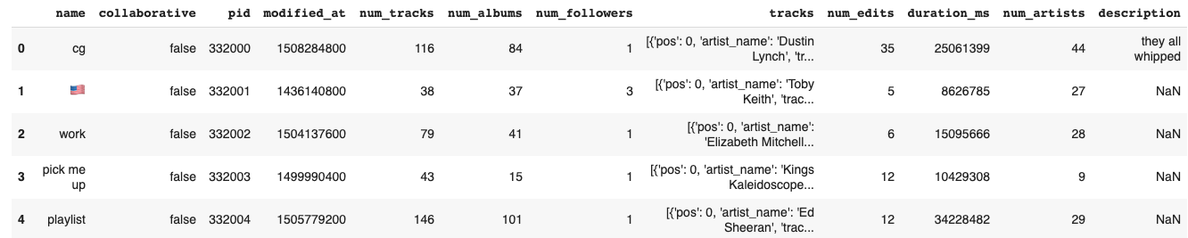
We wanna recommend songs to playlist ‘cg’

Slide 9

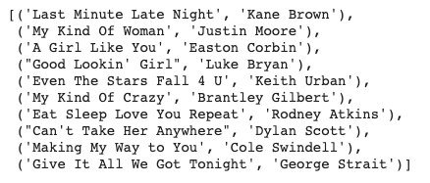
Item to item recommendation
create a similarity matrix for each song in the dataset
Jaccard index: {p_k} is a set of playlists that contain song k.
Output: top 10 songs with the largest similarity to playlist ‘cg’

Slide 10
Collaborative Filtering
03
PART

Slide 11
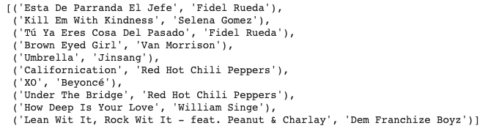
ALS model 1: rates Presence of song
created (playlist ID, track ID, rating) tuple where Rating is 1 if track in playlist or 0 otherwise.
Almost 300,000 different tracks!
Output: top 10 songs

Slide 12
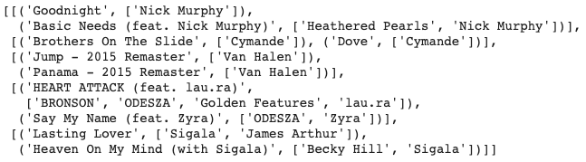
ALS model 2: rates count of artist
created (playlist ID, artist ID, rating) tuple where Rating is count of artist in playlist
Get top songs of artists from Spotify API
Only 50,000 unique artists
Top 2 songs of each artist
Output: top 5 artists
Nick Murphy
Cymande
Van Halen
ODESZA
Sigala

Slide 13
Music Genres Clustering
04
PART

Slide 14
Audio data
The audio data is obtained from Spotify API(https://developer.spotify.com/documentation/web-api/)
track_id | acousticness | danceability | duration_ms | energy | instrumentalness
key | liveness | loudness | mode | speechiness | tempo and valence

Slide 15
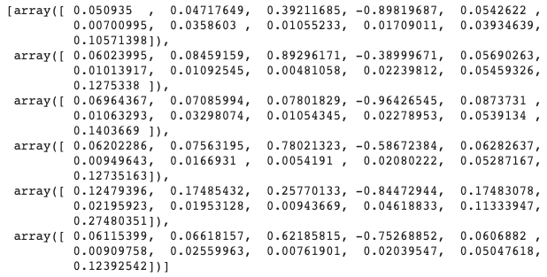
K-means clustering
classify all tracks into 6 groups
Define genre for each group
Model centers
0:'chill’
1:'rock’
2:'classical’
3:'pop’
4:'hip-hop’
5:'r-n-b'
Acousticness: acoustic
Valence: sad

Slide 16
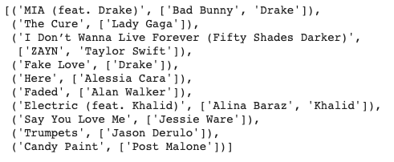
K-means clustering
Define playlist genre by most frequent track genre
Recommend songs based on playlist genre(via Spotify API)
Output: Top 10 songs of genre ‘pop’

Slide 17
Conclusion
05
PART

Slide 18
Conclusion
1. ALS model 2(rates count of artist) is sufficient to run on all 20,000 playlists.
2. Item to item recommendation and ALS model 1 can only recommend songs that exist in the dataset.
3. The output of clustering model is designed for genres rather than playlists.
🎉
ALS model 2 is our final model!

Slide 19
Reference
[1] https://www.aicrowd.com/challenges/spotify-million-playlist-dataset-challenge
[2] https://spark.apache.org/docs/latest/ml-collaborative-filtering.html
[3] https://github.com/vaslnk/Spotify-Song-Recommendation-ML/blob/master/EDA.ipynb
[4] https://developer.spotify.com/documentation/web-api/
[5] https://www.kaylinpavlik.com/classifying-songs-genres/

Slide 20
THANK YOU

